Slide 1
Protect your business from ransomware threats with improved data storage defenses using AI
Andy Walls
IBM Fellow and CTO FlashSystems
awalls@us.ibm.com linkedin.com/in/wallsandrew/

Slide 2










Cyber Attacks are on the Rise, getting more sophisticated
2X
Cyber Attacks YTY 2022 vs 2021, 2023 YTY 2.5x so far!
51%
of Cyber Attacks are ransomware (24%) or exfiltration (27%)
23
days, average recovery after a ransomware attack
26%
clients who paid the ransom still could not recover the data
66%
of breaches were not identified by the organization's internal security teams and tools
108
days faster identification and containment of a breach with extensive security AI & automation

Slide 3
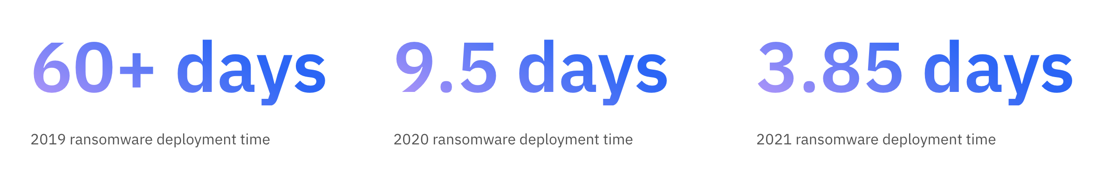
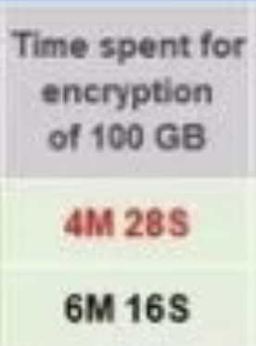
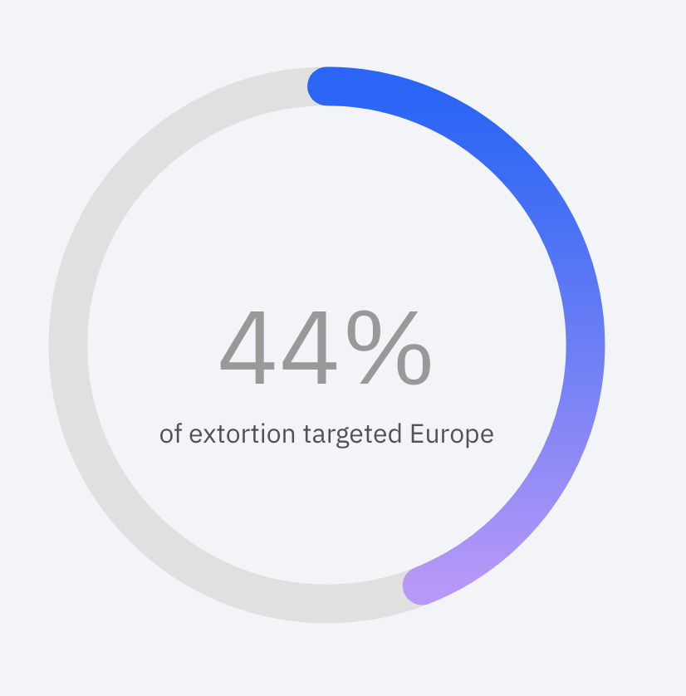
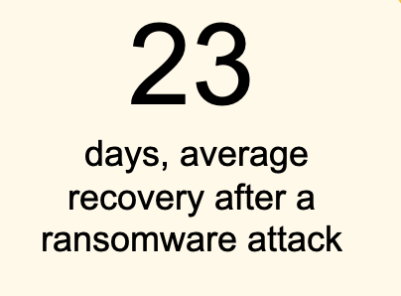
Bad actors are getting faster!
It takes less than 5 mins to encrypt 100GB
Too late if we detect AFTER encryption
Bad Actors are moving Faster
Less than 4 days to a Ransomware attack
Data Extortion on the rise
Takes over 287 days for full recovery

Slide 4





Secure & Resilient
Steps to Data Resilience
recovery
discovery
04
03
Rapid operational recovery in seconds, minutes, hours
Avoid paying ransoms
Find active threats
Find & prevent dormant threats
Automation & Testing
IMMUTABILITY
05
02
Simplified operations plus ability to test and prove recoverability
Integration between Cyber Security & Cyber Resiliency
Recoverable data points
Incorruptible, data can not be deleted
SECURITY & Data protection
01
Predict, prevent, and respond SOC Integration
Protect from infrastructure failures and Natural disasters

Slide 5
Storage is still on the hook!
Managing Threat Exposure needs prep, detection and recovery
Data Discovery
Data Risk Profiling
Attack Surface and Posture
Preparation
Threat Detection
Testing and Validation
Detection
“Safe” Recovery
Resiliency
Exposure Window is the time elapsed between when threat was detected to when it was remediated
Minimizing threat exposure involves detecting early, managing risk, recovering safely and swiftly

Slide 6
Paradigm shift: Need for Cyber Recovery
Cyber Recovery is fundamentally different from traditional recovery
Category | Traditional Recovery | Cyber Recovery
Nature of impact | Random e.g. natural disasters | Targeted engineered for maximum impact
Scope of impact | Local / Regional | Global affects all connected systems
Backup repository affected | Not typical | Yes 17% success in attacking backup
Recovery point | Known | Unknown need most recent uninfected copy
Mitigation objective | RPO/RTO | RPO/RTO + Safe Recovery
Duration of impact | Hours to Days | Days to Weeks
Relative probability of occurrence | Low | High
Need Early Detection
Need Safe
Recovery

Slide 7

IBM’s FlashSystem Vision … All Made Possible with FCM4
Vision
Achievement
Retain leadership in performance and density
Universally recognized as one of the highest performance, and highest density flash systems on the market.
Sustainability
World leader in numerous sustainability categories such as IOPS/Watt, IOPS per Rack U, Density per Rack U and more
Cyber Resilience Leaders and Cyber Detection Assistance
World leader in proactively detecting intrusion issues, reducing detection time to seconds. The quicker the issues are detected the less opportunity to cause harm.
AI Ops for Support and Ransomware Detection
IBM Storage Insights/Pro delivers advanced AI Ops and ML as part of an encompassing ransomware detection solution.

Slide 8
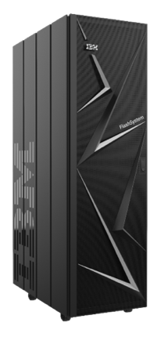
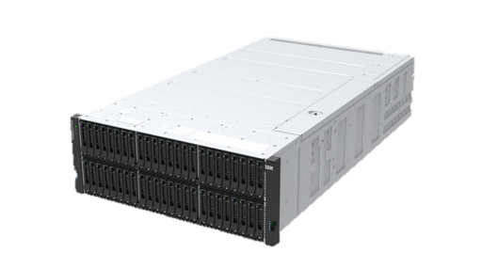
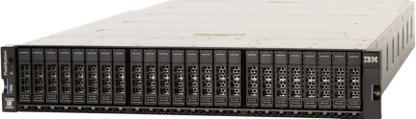
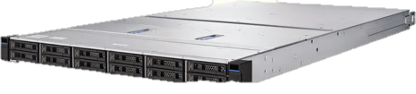

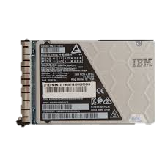
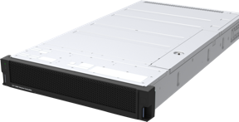
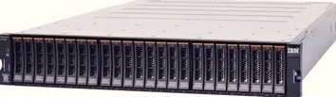
Entry Enterprise
Midrange Enterprise
High-End Enterprise
Hybrid Cloud
IBM Storage FlashSystem Family for Reference
Storage Virtualize
for Public Cloud
FlashSystem 9500
FlashSystem 7300
FlashSystem 5200
FlashSystem
5015 & 5045
SVC
The FlashCore Module
Storage function, scalability, interoperability, cloud integration and automation
IBM Storage Virtualize
IBM Storage Insights
Anomaly detection, fabric monitoring, full stack visibility, predictive support

Slide 9


Ransomware and other malware is becoming an epidemic! Every part of the stack needs to do its part
A Realization about Block Storage:
Block Storage is missing some context other parts of the system have
BUT: It can generate data needed for determining Ransomware attacks with less performance impact then any other part of the system
So, we started doing research into how ransomware affected systems containing FCMs

Slide 10


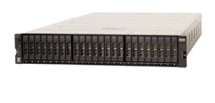

Built in Data Resilience to accelerate recovery from Ransomware attacks
IBM Safeguarded Copy prevents point-in-time copies of data from being modified or deleted by user errors, malicious destruction, or ransomware attacks – Logical Air Gap of Data
Separation of duties
Protected copies of data
Speed of recovery
Additional security capabilities to prevent non-privileged users from compromising production data
Capabilities to regularly create secure, immutable point in time copies – Up to 15,000 copies
Functionality that enables different use cases to restore corrupted data in minutes or hours vs days or weeks

Slide 11
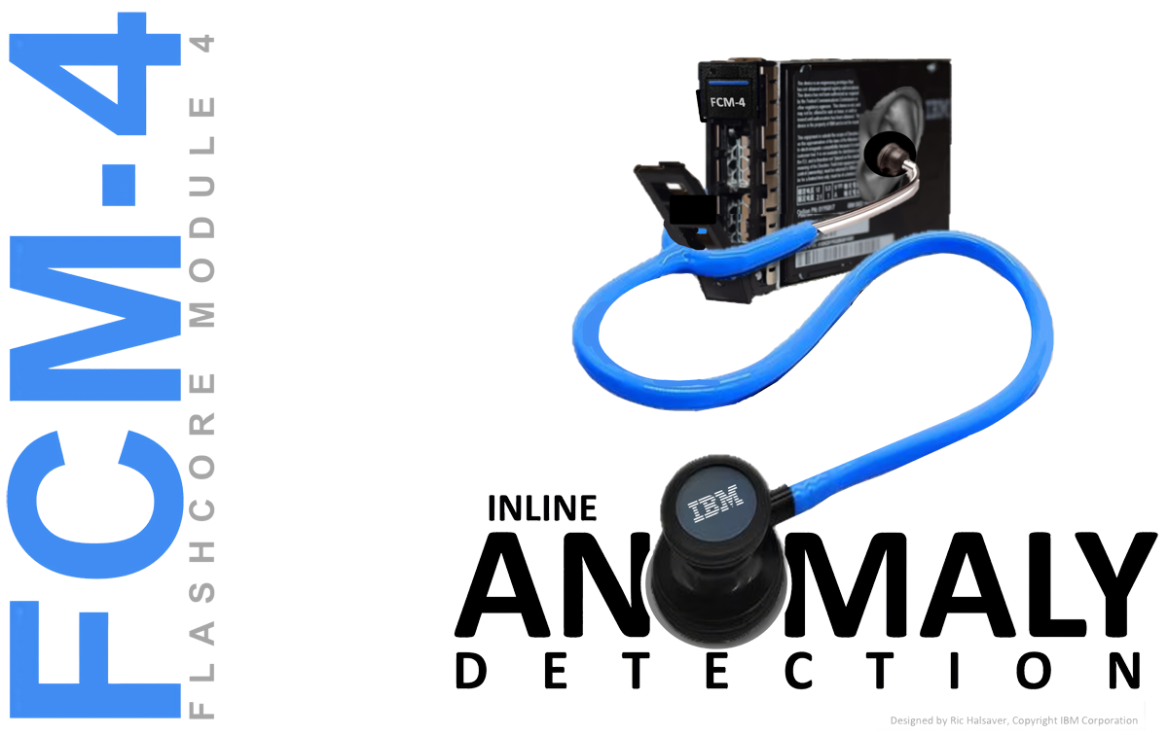
A Breakthrough in Cyber Security

Slide 12
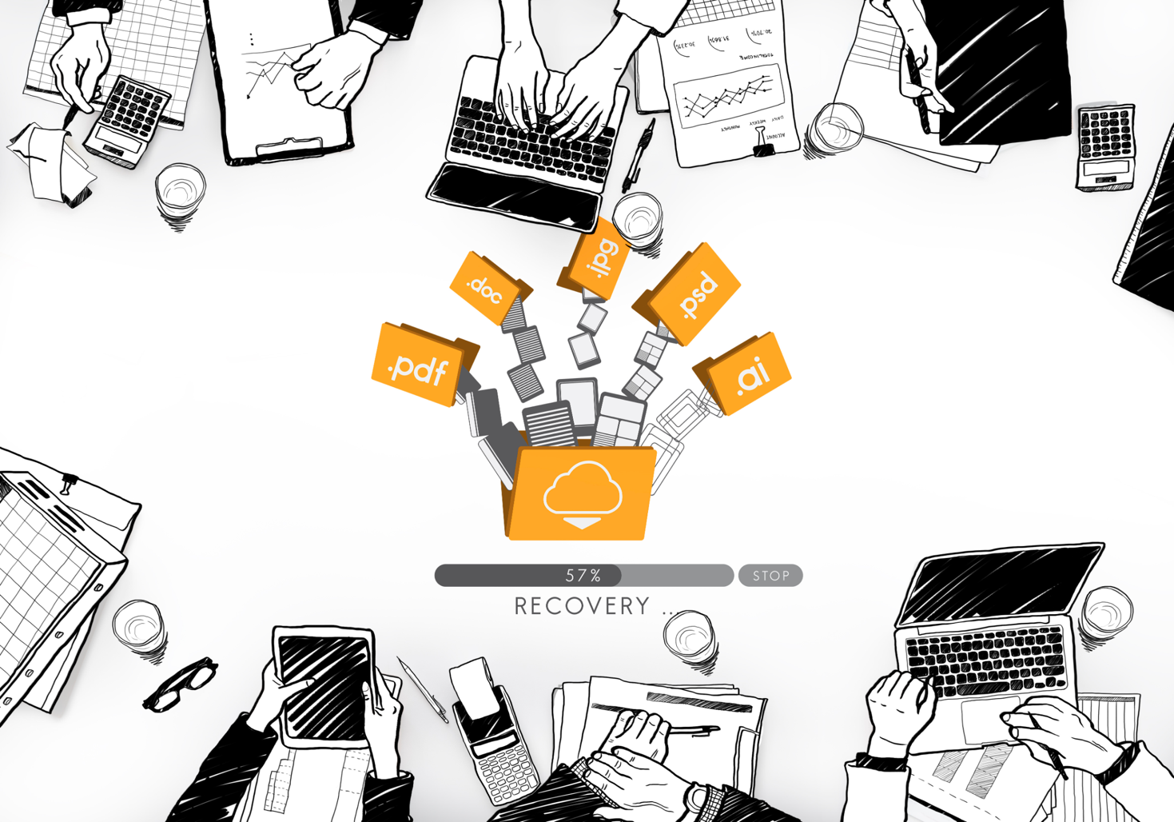

In Order to recover from Events, one must detect them early
We started with Threshold based Analytics
We sampled entropy and sent this back along with Compressibility to our Monitoring Engine.
Entropy and compressibility statistics sent back to the cloud-based Storage Insights (SI).
SI looked for trends as well as exceeding thresholds at volume level and sent alerts if met.

Slide 13
But we wanted to go further
Basic analytics can detect big changes in Compressibility and entropy
This can be useful beyond just ransomware detection.
And may indicate some ransomware attacks.
Many benign events look similar – False Positives
How about learning how different ransomware affects the block storage workload?
How is entropy and compressibility affected “on the fly” – the IOPs that are in progress.
What other attributes of the workload get affected on a real time basis?
This then requires statistics and characteristics be kept on a per IOP basis
One then can learn how these statistics behave for benign and Ransomware infected workloads.

Slide 14
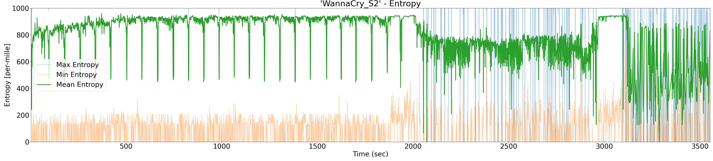
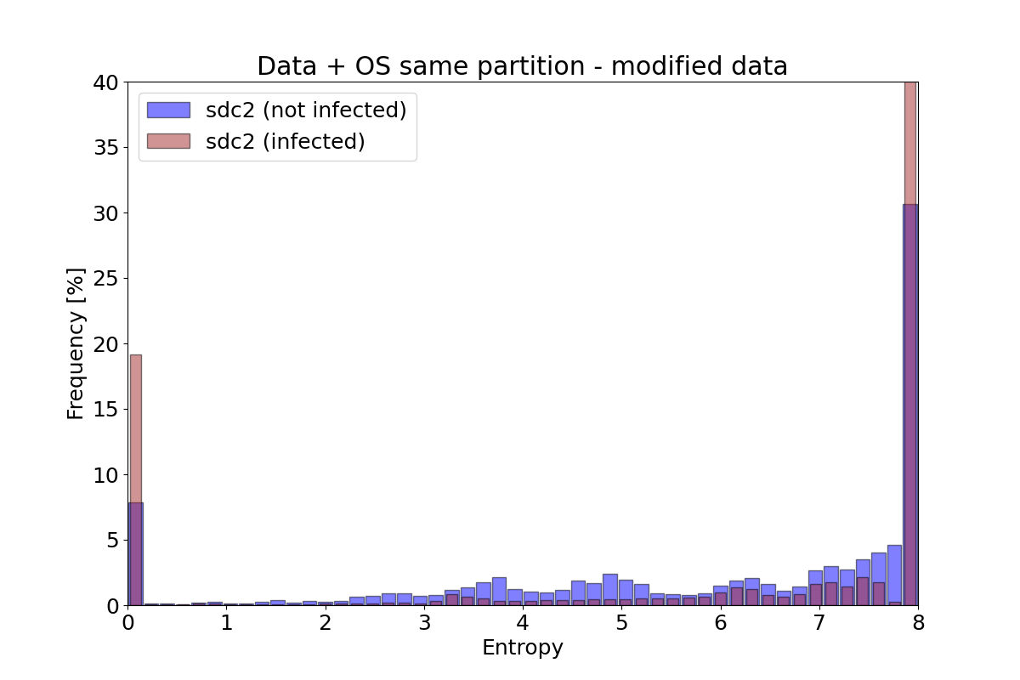
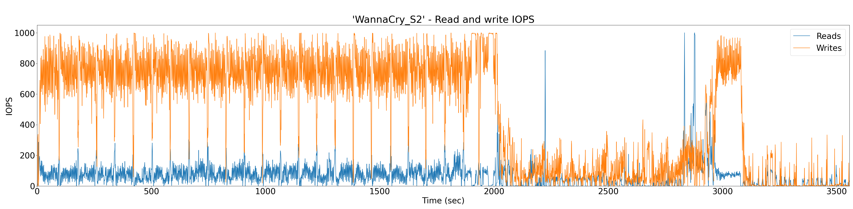
Characteristics Found in IO Traces from Ransomware
Malware such as ransomware attacks can be detected from storage IO patterns and data analysis
Example “Wannacry”:
Encrypted payload (– avg, – max, – min):
8.0
(high)
6.4
Payload encrypted – before and after attack:
4.8
3.2
1.6
0.0
(low)
IOPS (– read, – write):
28.04 %
Of data modified after the attack
IO activity of ransomware

Slide 15
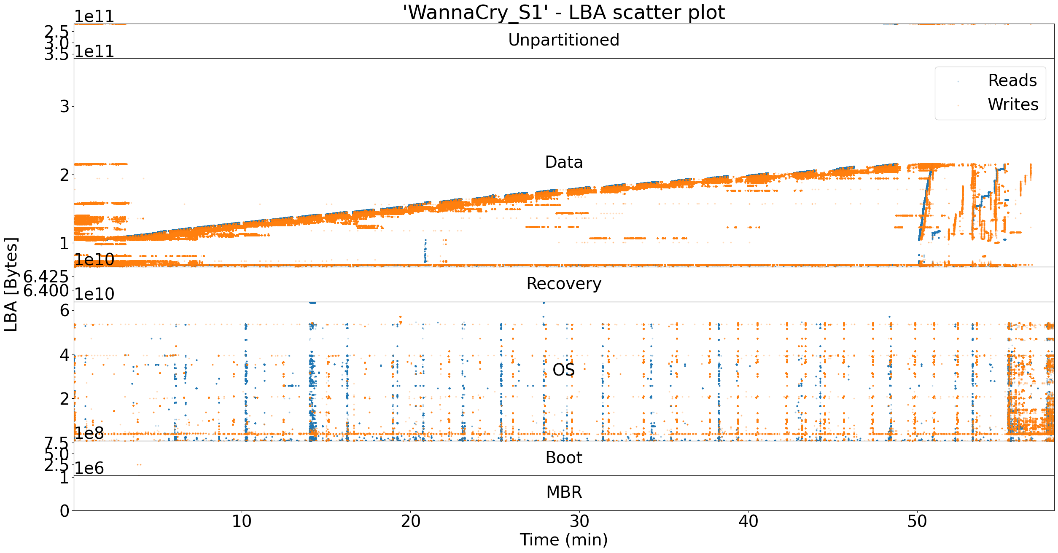
LBA Access Analysis – WannaCry - 1 Hour

Slide 16


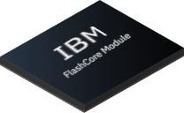



Ransomware Threat Detection With FlashCore Module
40+ data statistics analyzed in detection engine
Compression Statistics
Encrypted payload detection
Shannon Entropy
Chi-Squared
Changes in Read / Write Throughput
LBA Addressing and Sequencing Patterns
Processed on EVERY write with ZERO performance impact!

Slide 17
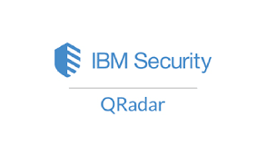




FlashSystem Ransomware Detection Conceptual Model
Spec V
Stats Collector (CCH), others
Sending and receiving data from IBM Security prods is probably too much of a stretch for 4Q.
Support Anomaly Detector
Ransomware Detect
The Revealer
(Inference Engine)
SI Stats
Aggregator
DRAID
LB
FCM 1
NVMe
FCM 2
NVMe
FCM 3
NVMe
FCM 4
NVMe
FCM 5
NVMe
FCM 6
NVMe
FCM N
NVMe
SUMMs
SUMMs
SUMMs
SUMMs
SUMMs
SUMMs
SUMMs
Entropy
Summarizer
Entropy
Entropy
Entropy
Entropy
Entropy
Entropy
Circ buf
Summarizer
Circ buf
Summarizer
Circ buf
Summarizer
Circ buf
Summarizer
Circ buf
Summarizer
Circ buf
Summarizer
Circ buf
. . . .
CMP Words in Page
CMP Words in Page
CMP Words in Page
CMP Words in Page
CMP Words in Page
CMP Words in Page
CMP Words in Page

Slide 18
Other Key Attributes of the Ransomware Detection Feature
We send samples of data collected when no alerts occur. We can then use these to understand real workloads.
Whenever an alert is raised, 1 hour of these traces is sent back to SI
If it is a False Positive, we can then train the model to understand that it was benign.
Updating the model uses the PATCH process.
    Security models must be updated frequently
    This process does not interrupt any data IO nor does it bring down either canister.
    After the Patch the Inference Engine and Model now have the latest!

Slide 19
Where can this go?
The more context that can be added the more accuracy
    We have ways of getting File System, OS and VM awareness.
Adding other stats and hints from other parts of the controller like port and host
Looking at time based models and using prior history to help accuracy
Imagine having AI Accelerator in the system that is learning specific parts of each systems behavior.

Slide 20




IBM’s Strategy: Address cyber threats with a holistic approach
 | Early Detection | Safe Recovery | SecOps Integration
Required capabilities | Layers of detection Real-time monitoring on primary arrays Offline scanning on snapshots and secondary copies Correlation across multiple layers and models Entropy monitoring Malware fingerprints Access patterns Application awareness Third-party intelligence | Data Isolation/Immutability Air Gap Immutable Snapshots Dual management controls Layers of Data Protection Primary snapshots Secondary backups Clean Recovery Point determination Scheduled testing Trust indexing | Integration with XDR tools Pre-filtered high-fidelity alerts Recovery planning Data inventory and prioritization Minimum viable company Integration with SOAR Playbook automation

